Slide 1
Fundamentals of CRE
Chemical Reaction Engineering
By
Dr Salah N. Farhan
Senior lecturer. Chem. Eng. Dept.
College of Engineering
University of Diyala
Salah N. Farhan College of Engineering Diyala University

Slide 2
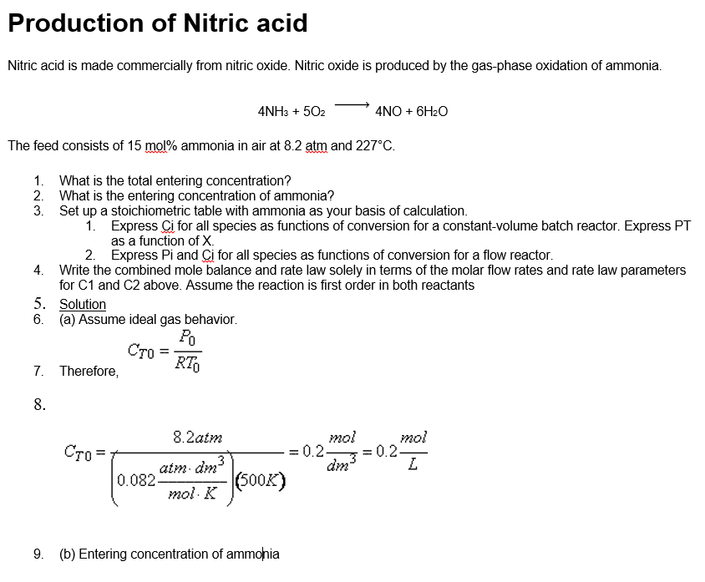
Fundamentals of CRE
Chapter 4: Stoichiometry
Learning Resources
Salah N. Farhan College of Engineering Diyala University

Slide 3
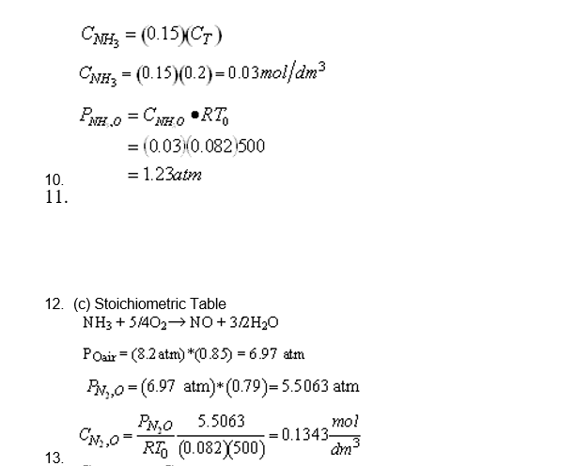
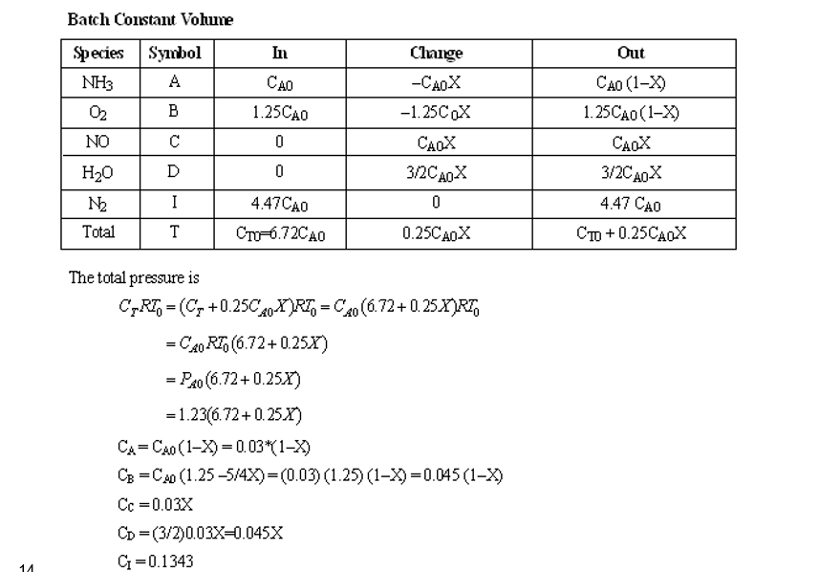
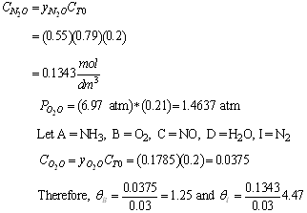
Fundamentals of CRE
Salah N. Farhan College of Engineering Diyala University

Slide 4
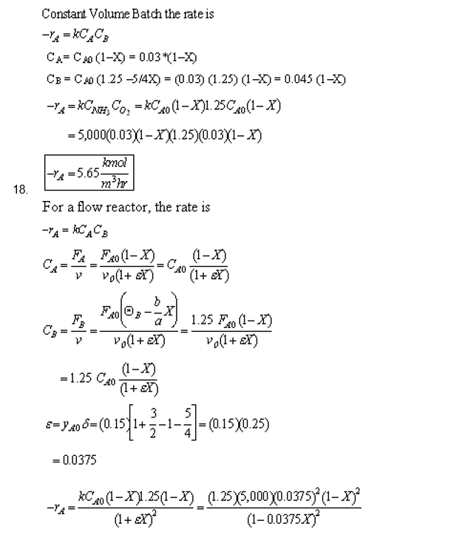
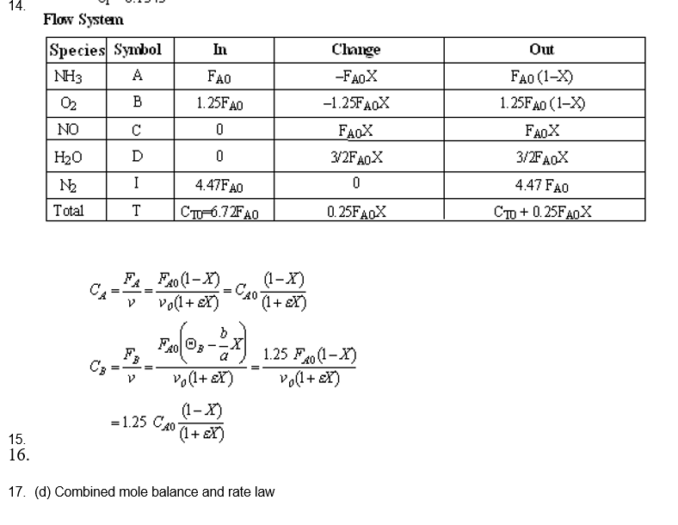
Fundamentals of CRE
Salah N. Farhan College of Engineering Diyala University

Slide 5
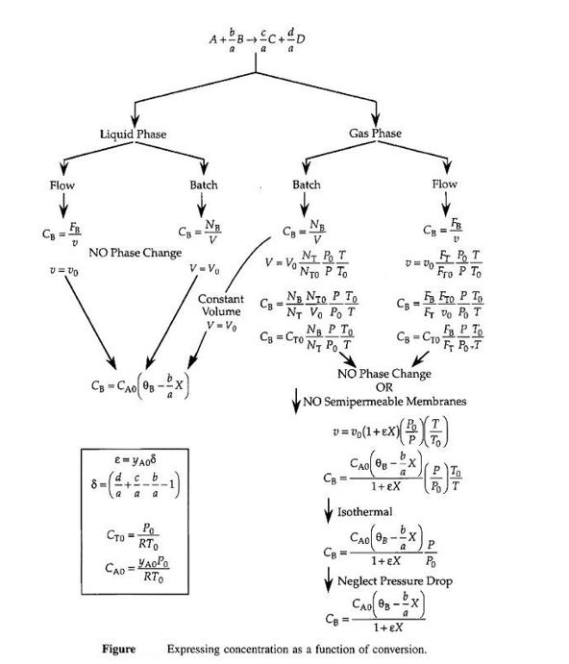
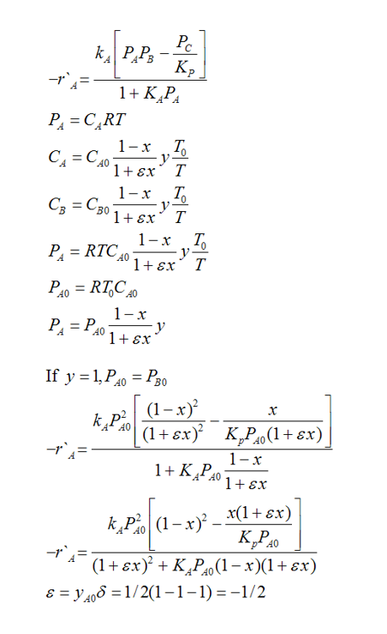
Fundamentals of CRE
Salah N. Farhan College of Engineering Diyala University

Slide 6
Fundamentals of CRE
Salah N. Farhan College of Engineering Diyala University

Slide 7
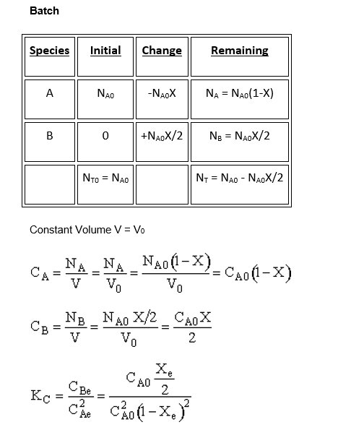
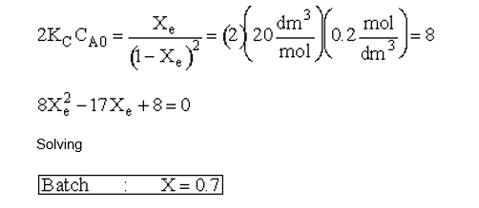
Fundamentals of CRE
Salah N. Farhan College of Engineering Diyala University

Slide 8
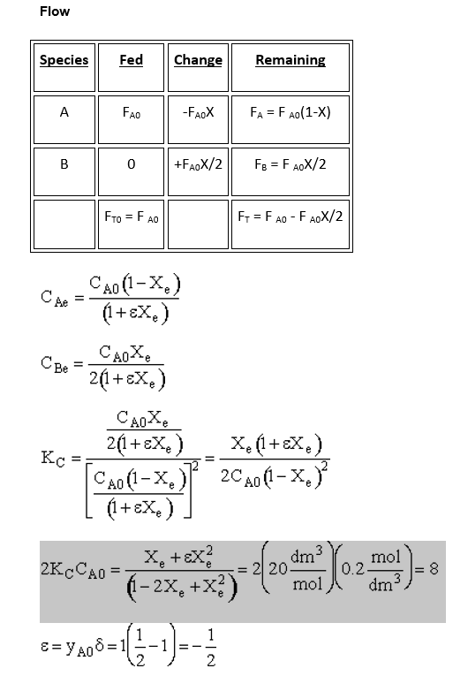
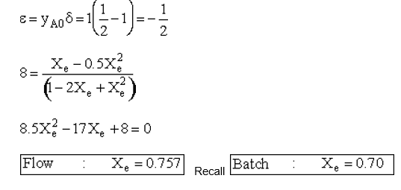
Fundamentals of CRE
Salah N. Farhan College of Engineering Diyala University

Slide 9
Fundamentals of CRE
Salah N. Farhan College of Engineering Diyala University

Slide 10
Fundamentals of CRE
Salah N. Farhan College of Engineering Diyala University

